Slide 1


Data Analysis
Notes:
Hello and welcome, my name is Duong and today I will be presenting to you the results of the Data Analytics task.

Slide 2


Today's agenda
Project recap
Problem
The Analytics team
Process
Insights
Summary
Notes:
Today, we'll discuss the project from start to finish. First, we'll review the main goals and challenges. Then, we'll focus on a specific issue the Data Analytics team is working on and explain why it's so important. Next, I'll introduce the team members involved and outline our approach to solving the problem. After that, I'll share the key findings and insights from our analysis, using visual ads to clarify the results. To conclude, I'll recap the main points and answer any questions you may have.

Slide 3

S
Social Buzz is a fast growing technology unicorn that need to adapt quickly to it’s globlal scale.
Accenture has begun a 3 month POC focusing on these tasks:
An audit of Social Buzz’s big data practice
Recommendations for a successful IPO
Analysis to find Social Buzz’s top 5 most popular categories of content
Project Recap
Notes:
Accenture has partnered with Social Buzz for a three-month pilot project to address key challenges. Given Social Buzz's significant growth, we're offering expertise in managing scale and preparing for an IPO. Our focus areas include:
Auditing big data practices: Sharing best practices and industry knowledge.
Guiding the IPO process: Leveraging our team's deep experience.
Analyzing content popularity: Identifying insights into the top 5 content categories.

Slide 4

Problem
Over 100000 posts per day
36,500,000 pieces of content per year!
But how to Capitalize on it when there is so much?
Analysis to find Social Buzz’s top 5 most popular categories of content
Notes:
The Data Analytics team has been focusing on analyzing the vast amount of data generated by your platform. With over 100,000 posts per day, it's a challenge to make sense of all this unstructured information.
In today's content-driven world, understanding and analyzing data is crucial for providing personalized experiences. While simply collecting content is important, the real value lies in understanding your audience and tailoring your offerings.
Our data analytics expertise has uncovered valuable insights that can guide you in implementing scalable analytics solutions, helping you capitalize on your vast amount of data.

Slide 5



The Analytics team

Slide 6
Process
1
Data Understanding
2
Data Cleaning
3
Data Modelling
4
Data Analysis
5
Uncover Insights
Notes:
We followed a five-step approach:
Data understanding: Thoroughly analyzed the data model and business context.
Data extraction: Designed an ideal dataset and extracted data from relevant sources.
Data processing and modeling: Transformed raw data into a dataset suitable for analysis.
Insight discovery and visualization: Used analytical expertise to uncover insights and create visualizations.
Business decision-making: Applied insights to make recommendations and inform future actions.
Data Understanding: Laying the Foundation
The initial step in our data analysis journey was a deep dive into the intricacies of Social Buzz's data landscape. We meticulously examined the underlying data model, unraveling the complex relationships and interdependencies between various data entities. This comprehensive understanding served as the bedrock upon which we could construct a robust analytical framework.
Data Extraction: Curating the Raw Material
Armed with a clear understanding of the data model, we proceeded to architect an ideal dataset tailored to address the specific business questions at hand. This involved carefully selecting the most relevant data sources and designing an efficient extraction process. By meticulously extracting the raw data from these sources, we laid the groundwork for subsequent analysis.
Data Processing and Modeling: Transforming Raw Data into Insights
Once the raw data was extracted, we embarked on a rigorous data processing and modeling phase. This involved cleaning, transforming, and integrating the data to ensure its quality and consistency. By applying appropriate statistical techniques and machine learning algorithms, we transformed the raw data into a structured dataset that could be leveraged to extract meaningful insights.
Insight Discovery and Visualization: Unlocking the Hidden Gems
With a well-prepared dataset in hand, we employed our analytical expertise to uncover the hidden gems within the data. By leveraging advanced statistical techniques and data visualization tools, we delved deep into the data to identify patterns, trends, and correlations. These insights provided valuable information about user behavior, content performance, and engagement metrics.
Business Decision-Making: Translating Insights into Action
The ultimate goal of our analysis was to drive informed business decisions. By translating the insights gleaned from the data into actionable recommendations, we empowered Social Buzz to make data-driven choices that would enhance their platform's performance and user experience. These recommendations covered a wide range of areas, including content strategy, user acquisition, and personalization efforts.

Slide 7

Insights
16
Unique Categories
1091
Reactions to “Food” posts
February
Month with
most posts
Notes:
From your data we found that you had a total of 16 unique categories of posts across your sample dataset. This includes things such as Food, Culture and Sport.
As well as this, there was 1091 posts from just the Food category alone! People obviously really like food!
And also the most common month for users to post within was December, since this is such a seasonal month with so many holidays and events, this is interesting to know that people are most active during this month!
But now, onto the main question... which is... what were the top 5 most popular categories of posts?

Slide 8
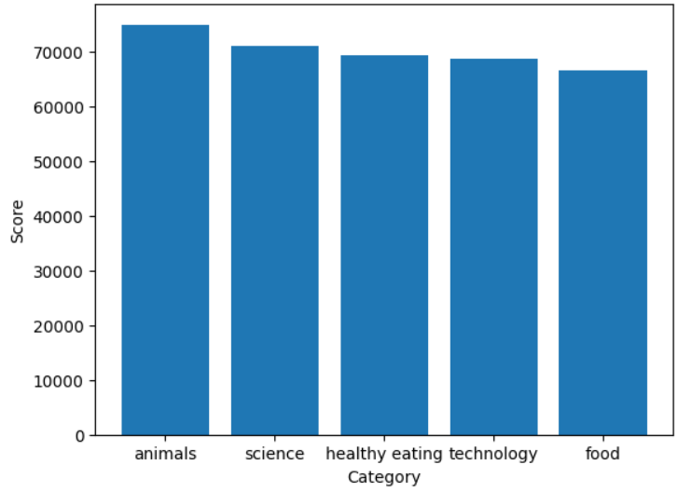

Slide 10

ANALYSIS
People seem to favor content that's grounded in reality and based on facts, as evidenced by the popularity of science and technology topics.
INSIGHT
The prevalence of food-related topics in the top 5 categories, particularly 'Science,' indicates a potential audience preference. To tap into this, you might explore creating a campaign around healthy eating and partnering with relevant brands to boost user engagement.
Summary
NEXT STEPS
This analysis is a great start, but for ongoing, real-time understanding, we can show you how to deploy it at scale.
Notes:
Top 5 Most Popular Categories
Our analysis successfully identified the top 5 most popular content categories on Social Buzz:
Food
Science
Technologies
Eating Healthy
Animals
Key Insights
Real-life content: Users demonstrate a preference for authentic and relatable content, such as food and culture.
Timely opportunities: The popularity of soccer, especially with the upcoming tournament, presents a significant opportunity for growth and engagement.
Next Steps: Leveraging Insights in Production
While these findings provide valuable insights, the real power lies in translating them into actionable strategies. Accenture is equipped with the expertise and resources to help Social Buzz implement these insights across the organization in real-time. By leveraging data-driven insights, Social Buzz can optimize content recommendations, personalize user experiences, and drive overall platform growth.
We are committed to supporting Social Buzz in realizing the full potential of its data and achieving its business objectives.

Slide 11
Thank you!
ANY QUESTIONS?

